Slide 1


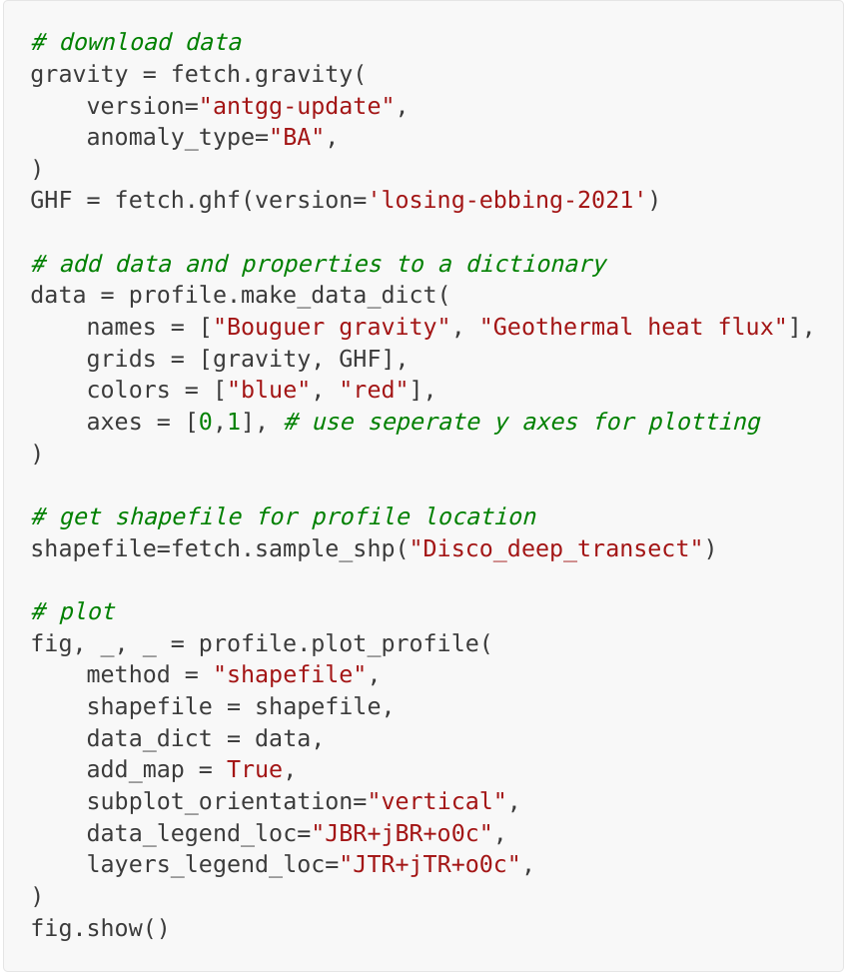
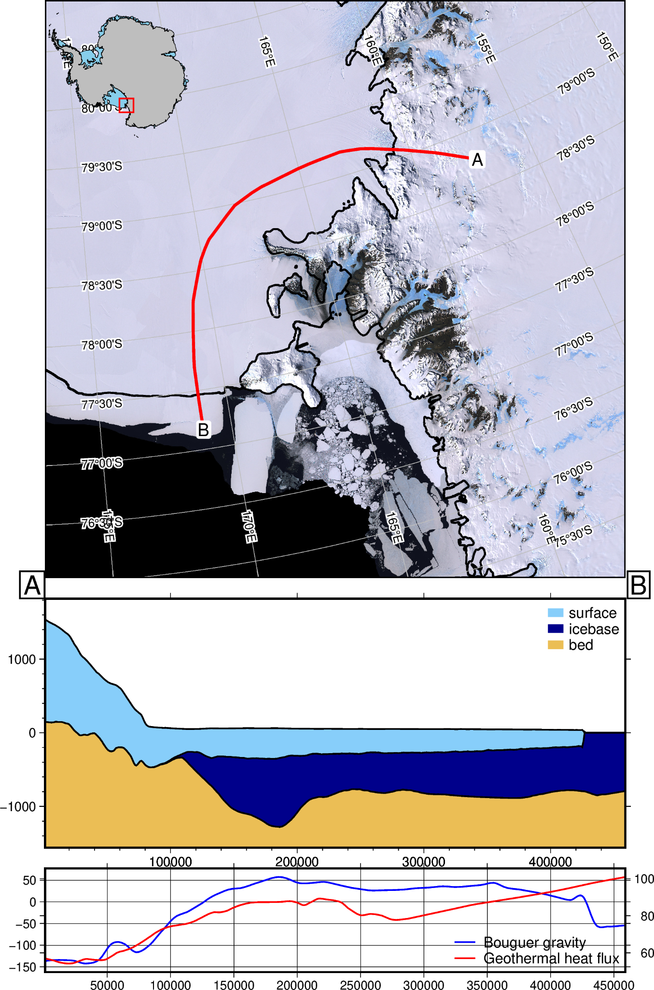


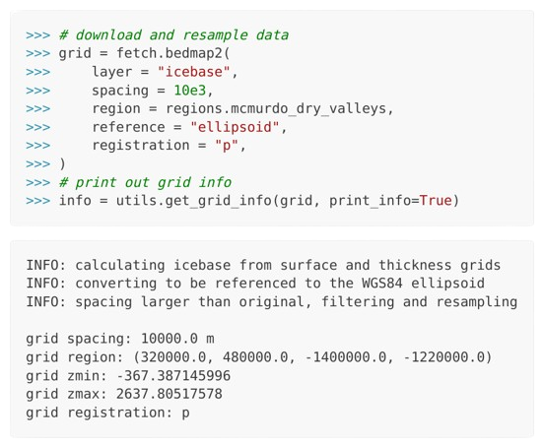
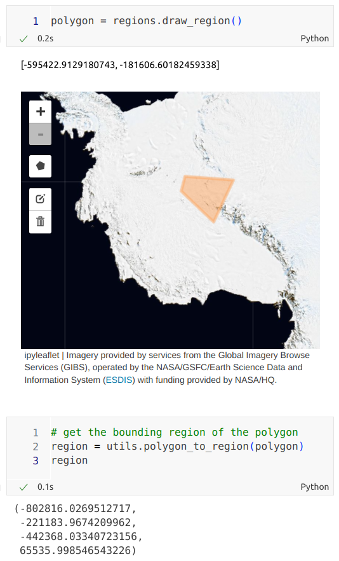
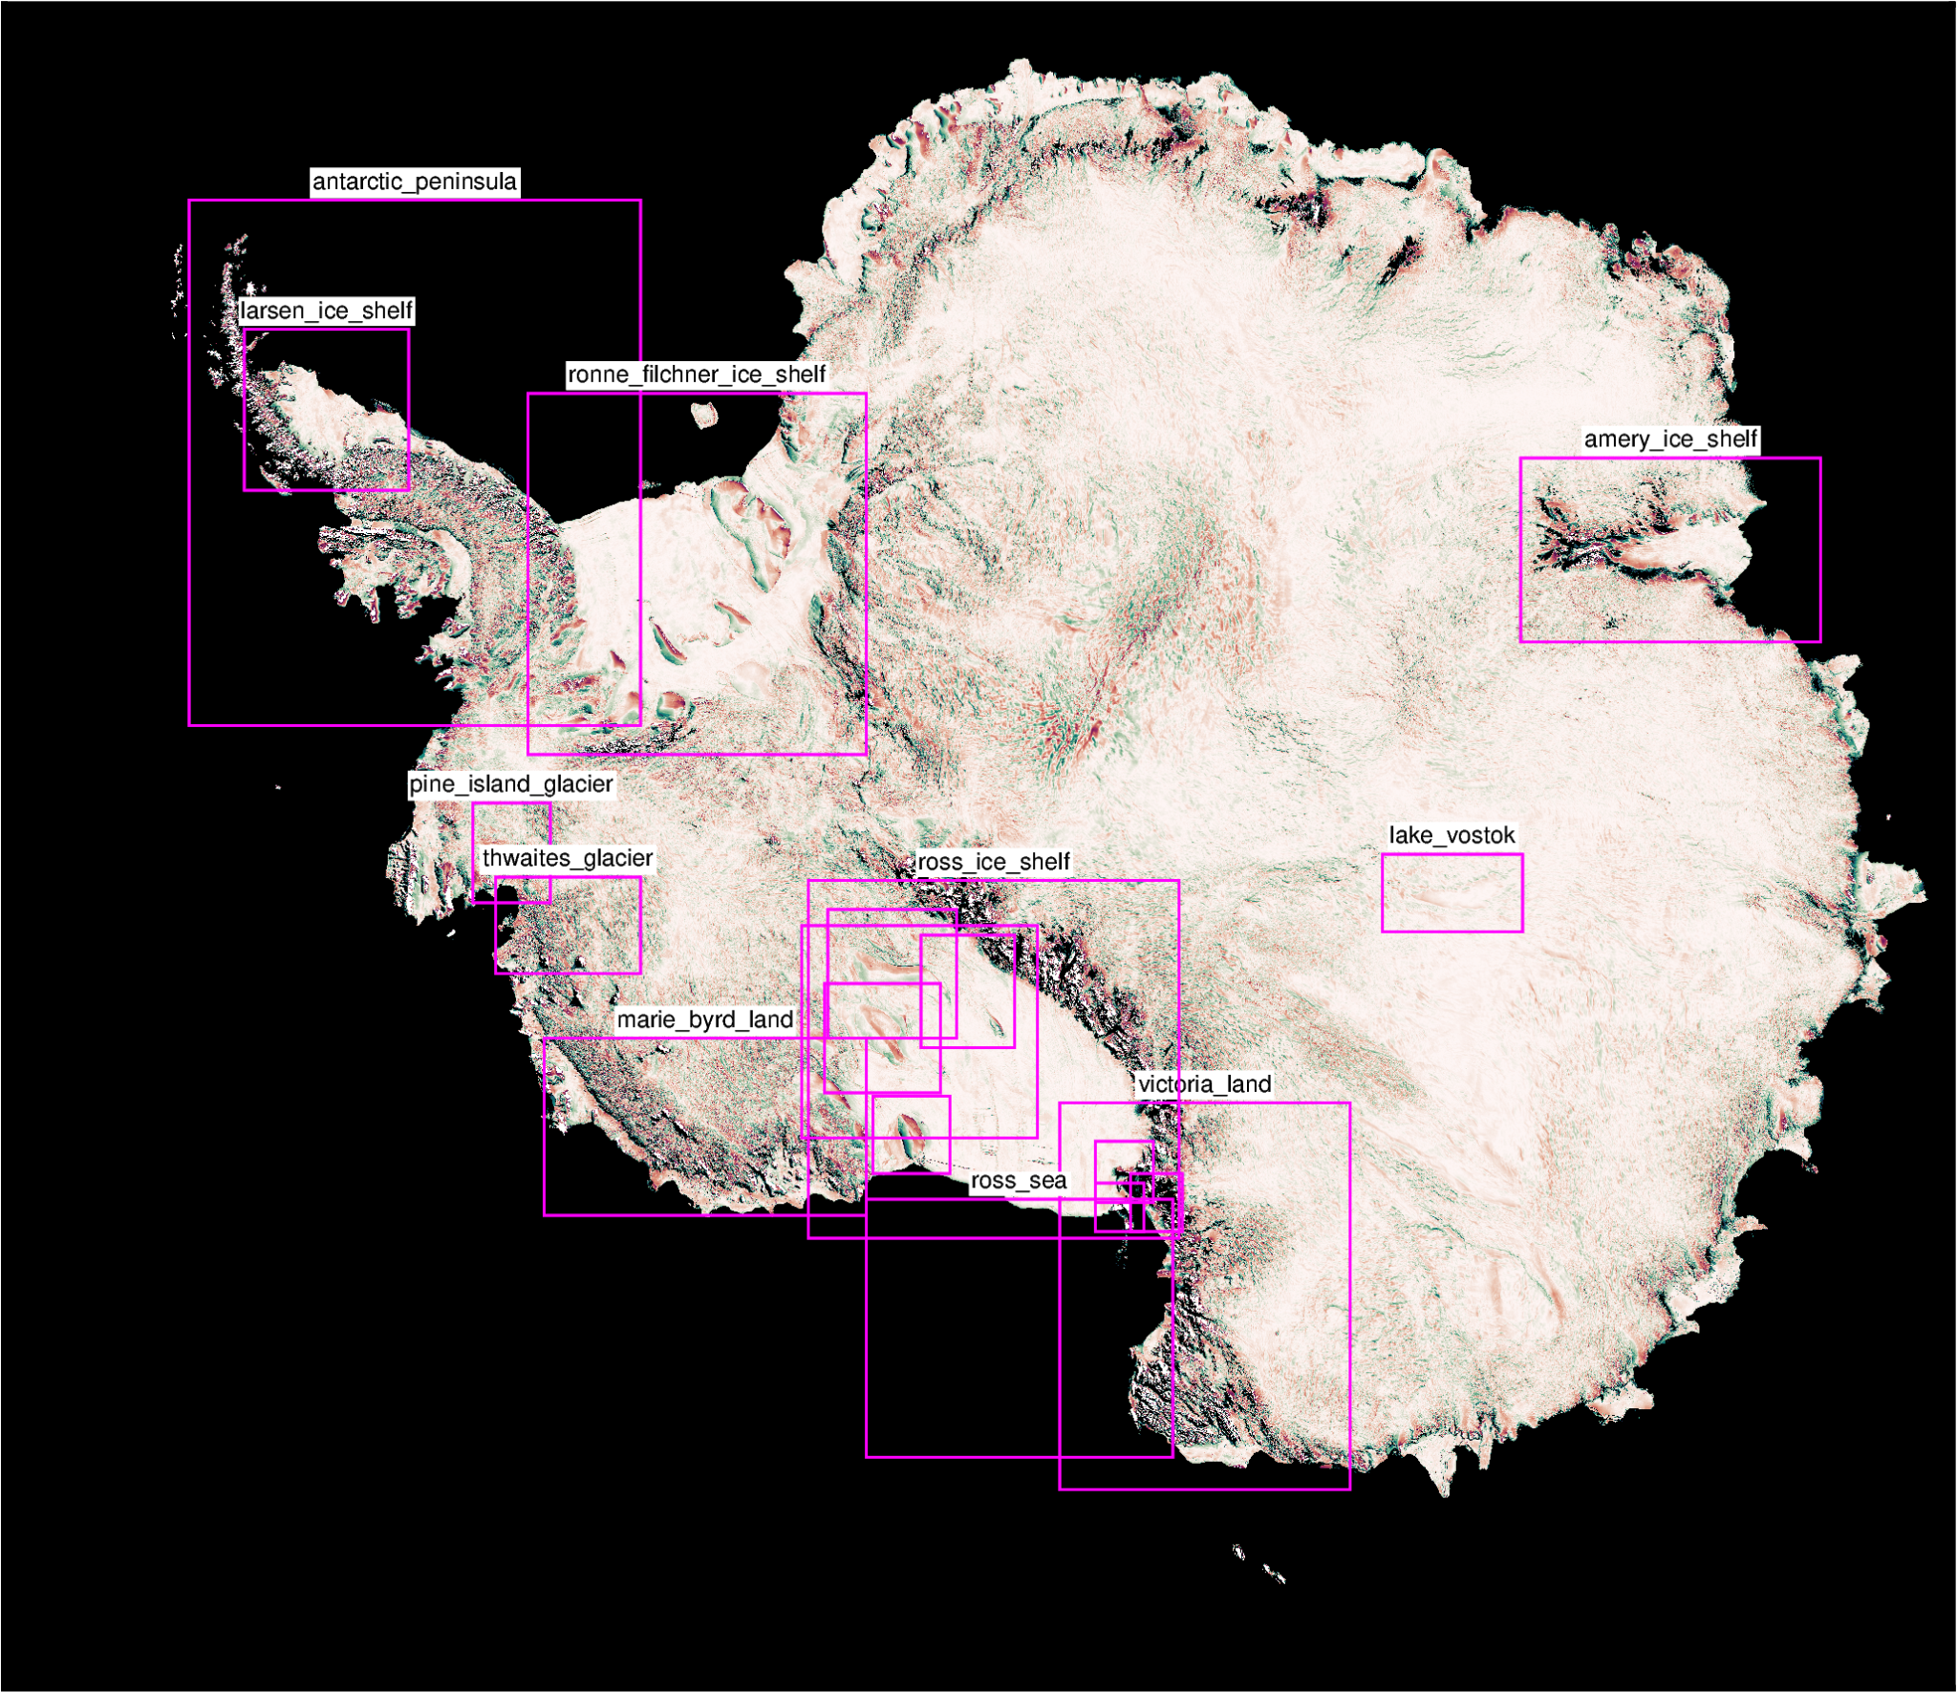
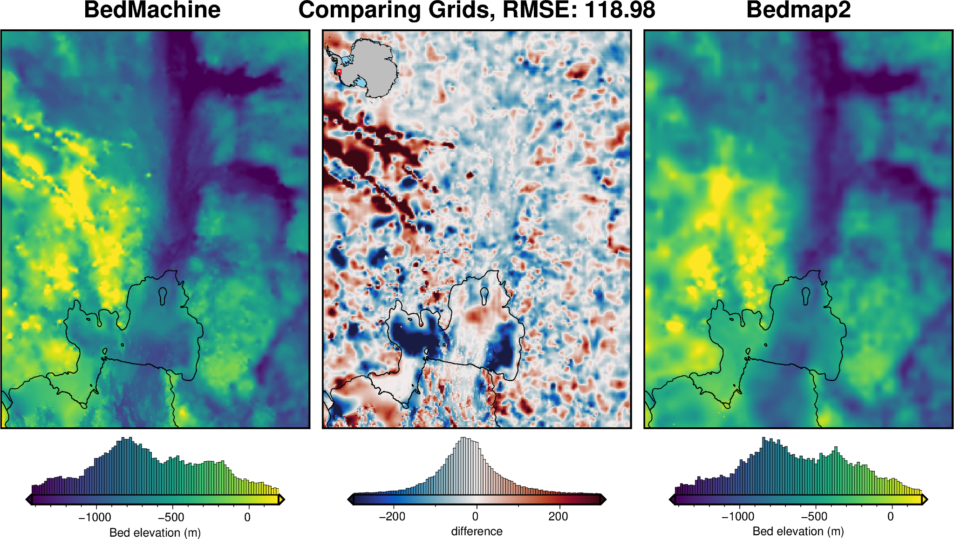
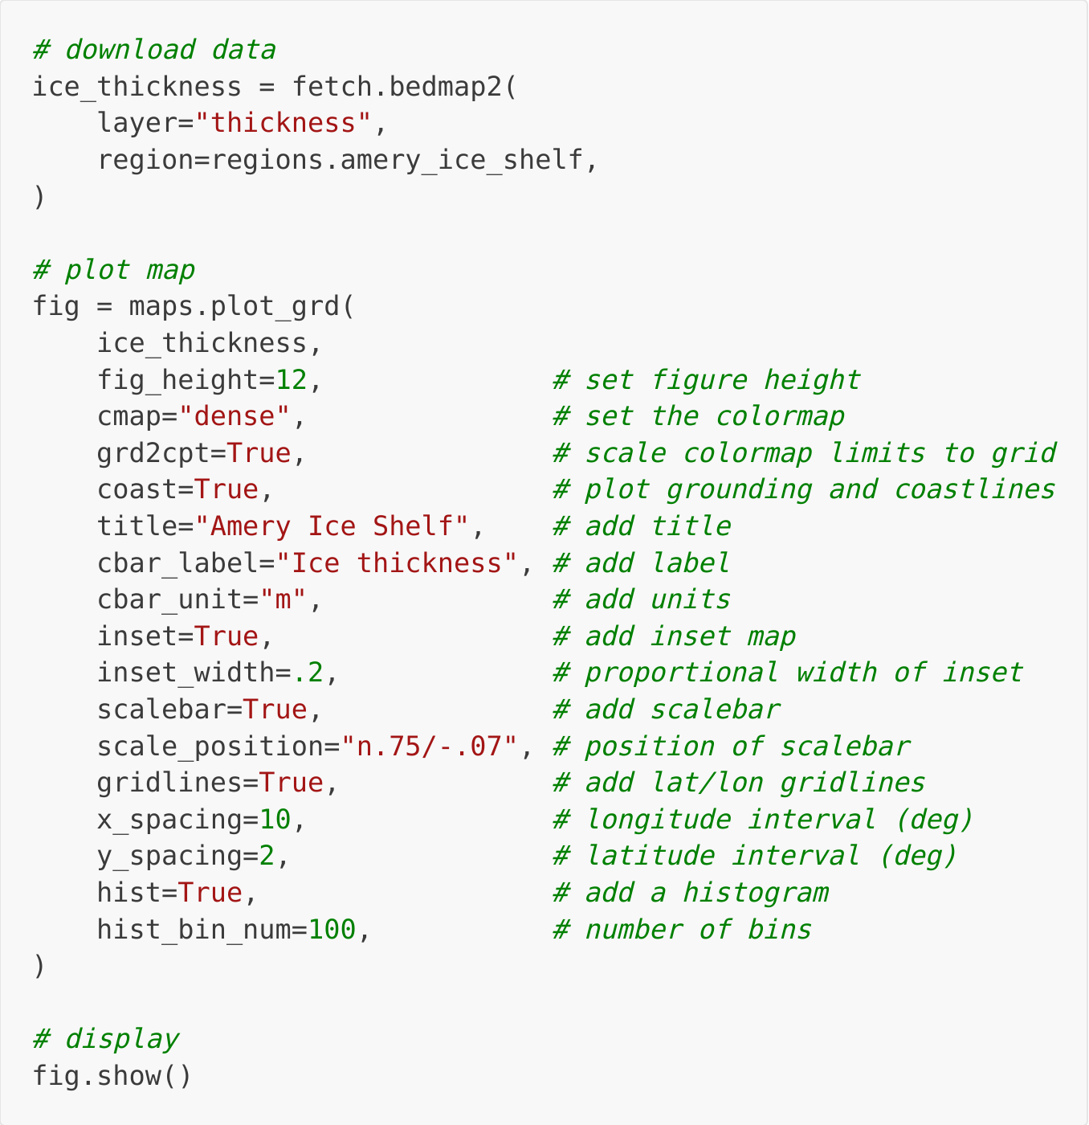
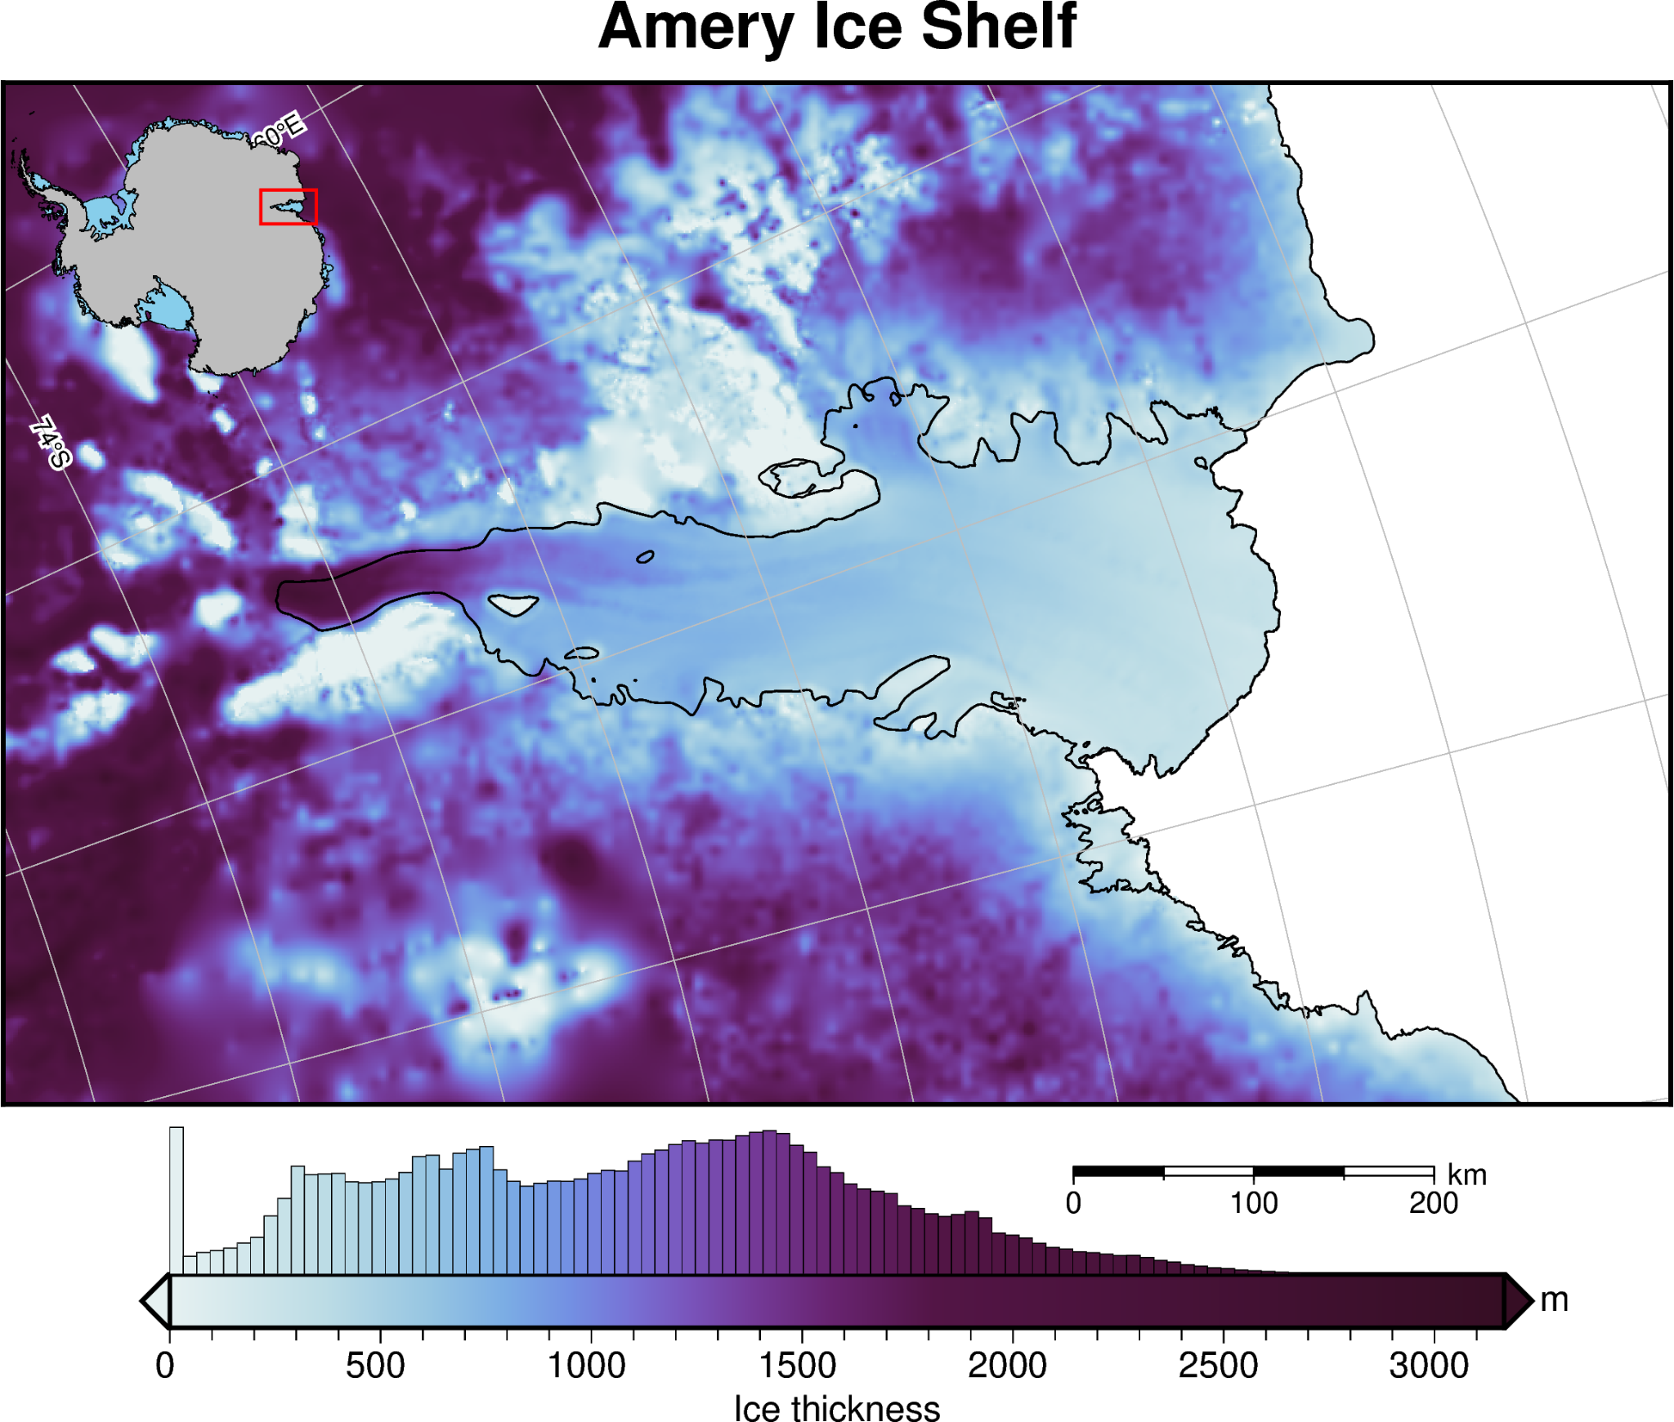
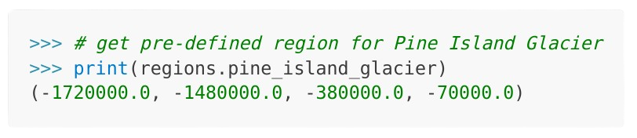
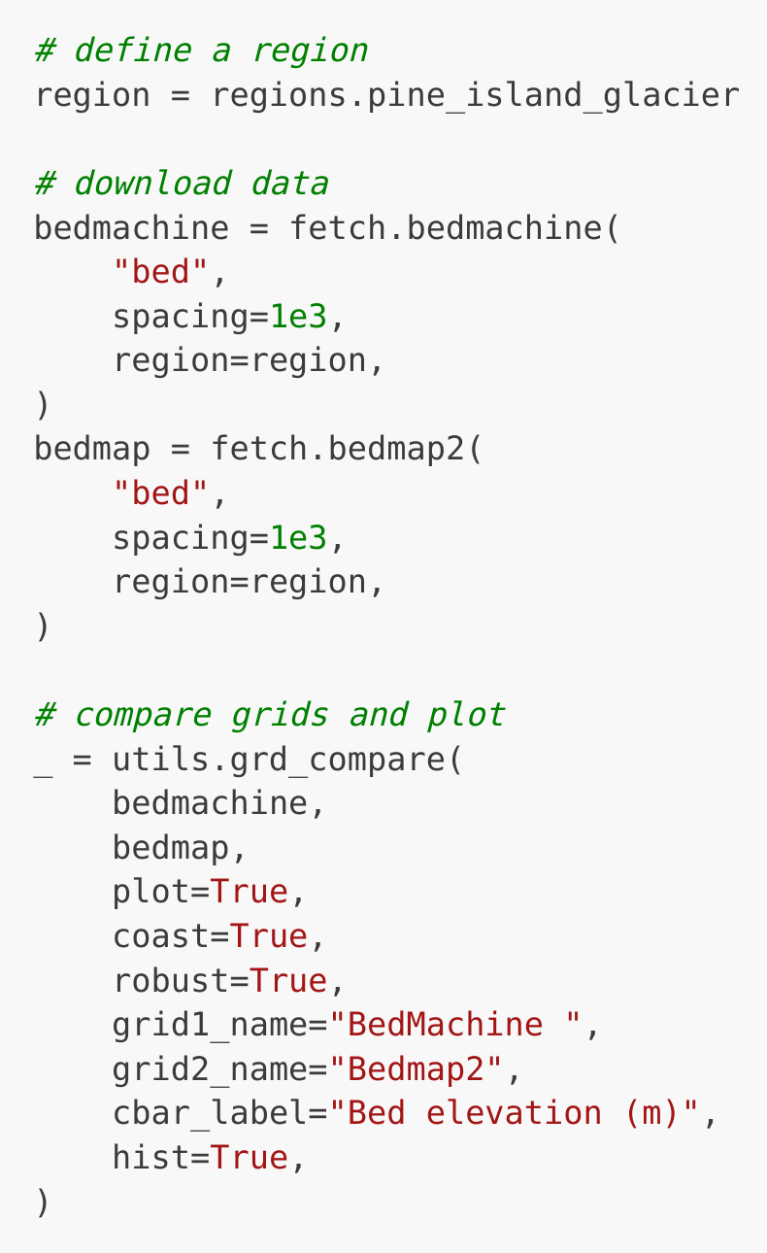
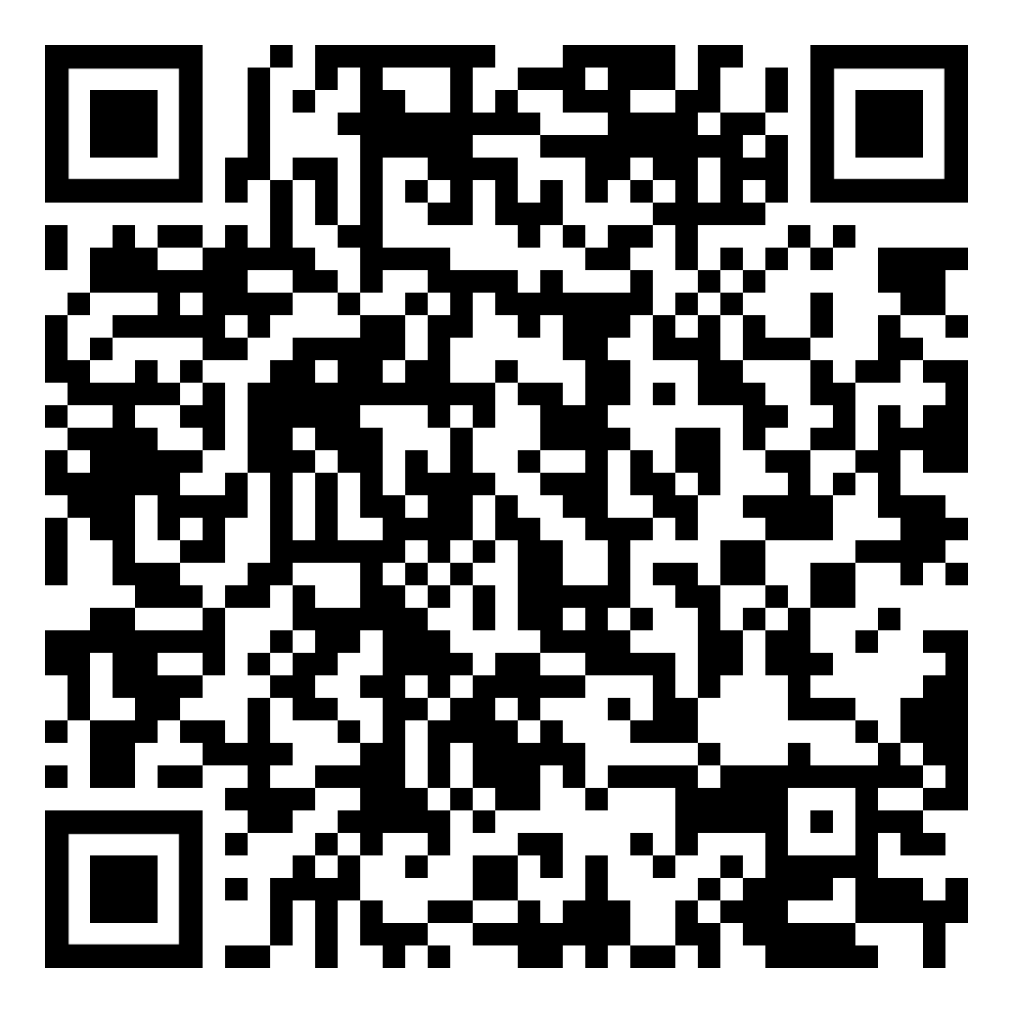
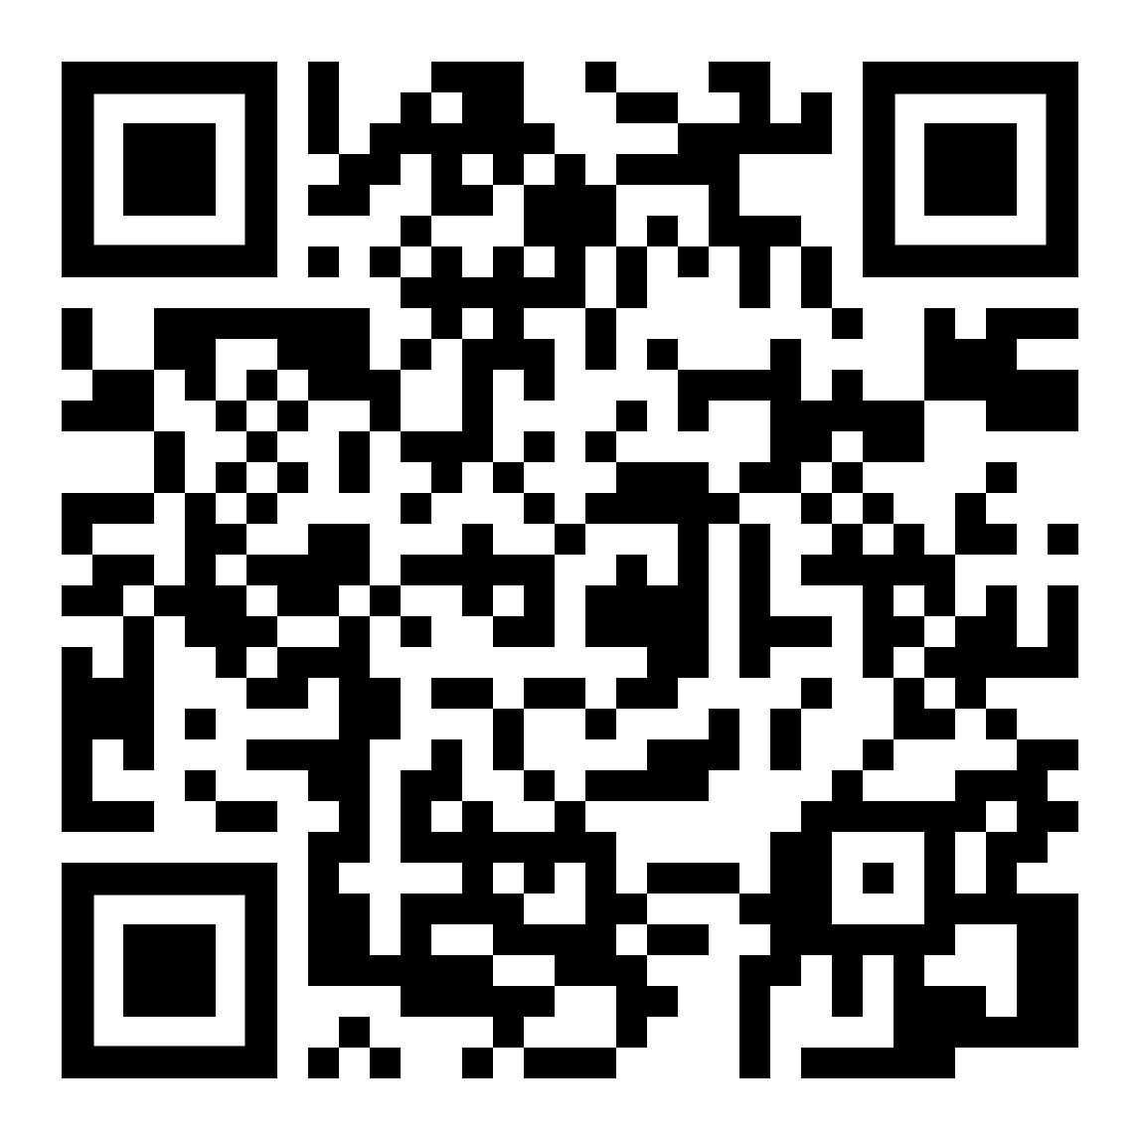
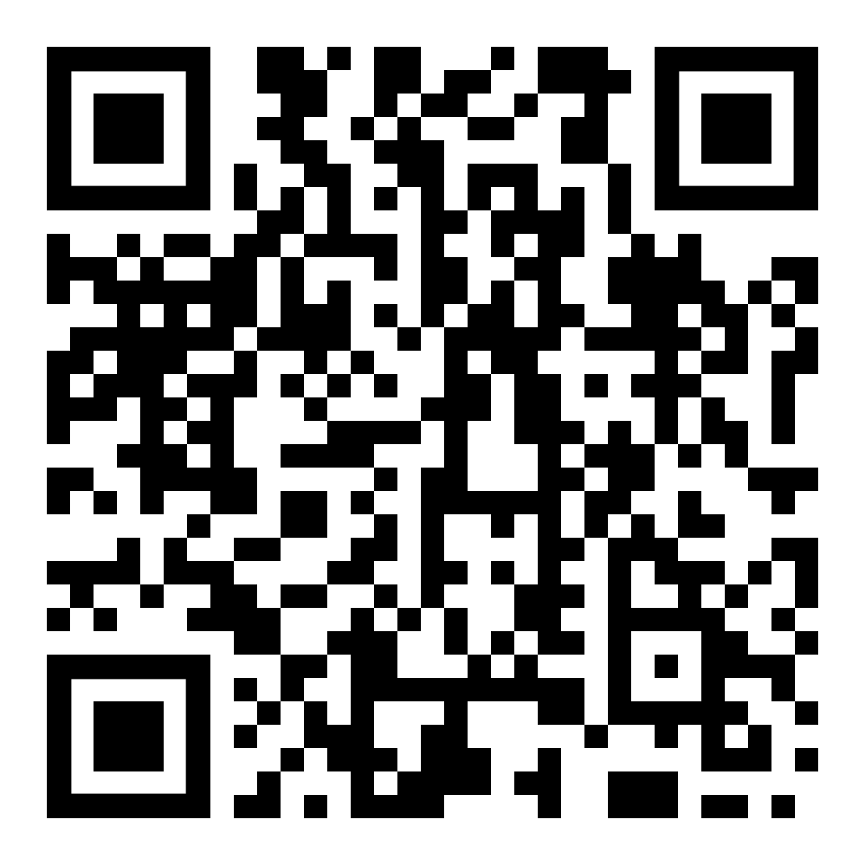


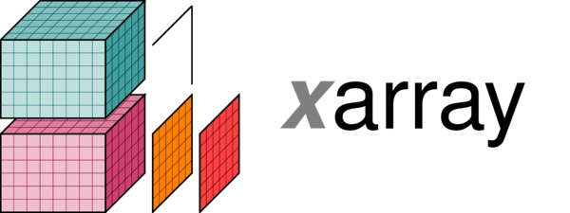

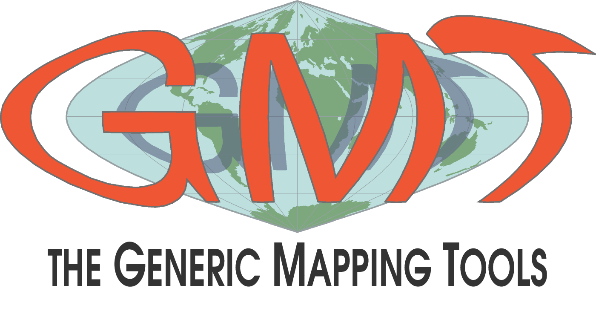
Antarctic-Plots:
a Python Package to Help Conduct Antarctic Research
interactively-defined
available regions
2) from antarctic_plots import fetch
Easily download data sets to your computer, retrieve previously download data sets, and perform common gridded data manipulations. This module uses `Pooch` to managed the download, storage, and retrieve of data, and `PyGMT` for grid manipulations. Below are some of the currently implemented datasets:
4) from antarctic_plots import profile
Define a line, sample layers & data along it, and plot the results.
3 methods of defining a line:
straight line between 2 points
interactively draw a line
shapefile
Matt Tankersley
matt.d.tankersley@gmail.com
http://antarctic-plots.rtfd.io/
https://github.com/mdtanker/antarctic_plots
Imagery:
LIMA
MODIS MOA
Topographic data:
BedMachine
Bedmap
REMA
ETOPO
geoid models
IBCSO
Glaciological data:
basal melt
ice velocity
mass or height change
Geophysical data:
gravity
magnetics
geothermal heat flux
glacio-isostatic adjustment
Derived data:
basement topography
crustal thickness
sediment thickness
moho depths
Shapefiles:
GeoMAP faults / outcrops
grounding / coast lines
ice shelf / catchment boundaries
Overview
Antarctic-Plots is a Python package developed to help with conducting Antarctic science. It consists of 5 modules, presented here, each providing a unique set of tools to help with a variety of common tasks.
1) from antarctic_plots import regions
Pre-defined or interactively chosen geographic regions. Includes many ice shelves, glaciers, and general geographic regions. These can be used in functions throughout, such as subsetting data or specifying areas to plot.
5) from antarctic_plots import utils
Useful functions for common tasks: coordinate conversion, grid comparison, masking, de-trending.
3) from antarctic_plots import maps
Create high-quality maps using PyGMT with functions specifically tailored to Antarctica.
plot types: 2D, 3D, subplots, interactive maps
Have a dataset you want included?
Want to add your study region?
Want some additional mapping features?
Raise an issue on GitHub or contribute yourself!
Try it on your phone:
Open a Binder environment
Checkout the website:
antarctic-plots.rtfd.io

